Slide 1

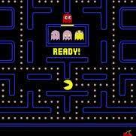

Module 3.1
How do computers make decisions?
Living and Working with Artificial Intelligence
Unit 3
Machine Learning &
Automated Decision-
Making
Developed for the AI4GA (Artificial Intelligence for Georgia) project funded by National Science Foundation awards DRL-2049029 and DRL-2048502.
This work is licensed under the Creative Commons. Attribution-NonCommercial-ShareAlike 4.0 International License. https://creativecommons.org/licenses/by-nc-sa/4.0/

Slide 2
Kinds of decisions computers can make
Classification
Prediction
Recommendation
Planning and scheduling
An algorithm that performs one of these decision-making tasks is called a reasoner.
There can be multiple reasoning algorithms for the same task. For example, there are many classification algorithms, i.e., many types of reasoners that do classification.
Notes:
Other Notes - Learning goal - understand the kind of problems
Brainstorm - about reasoning
Teach them
Robot or not esq

Slide 3
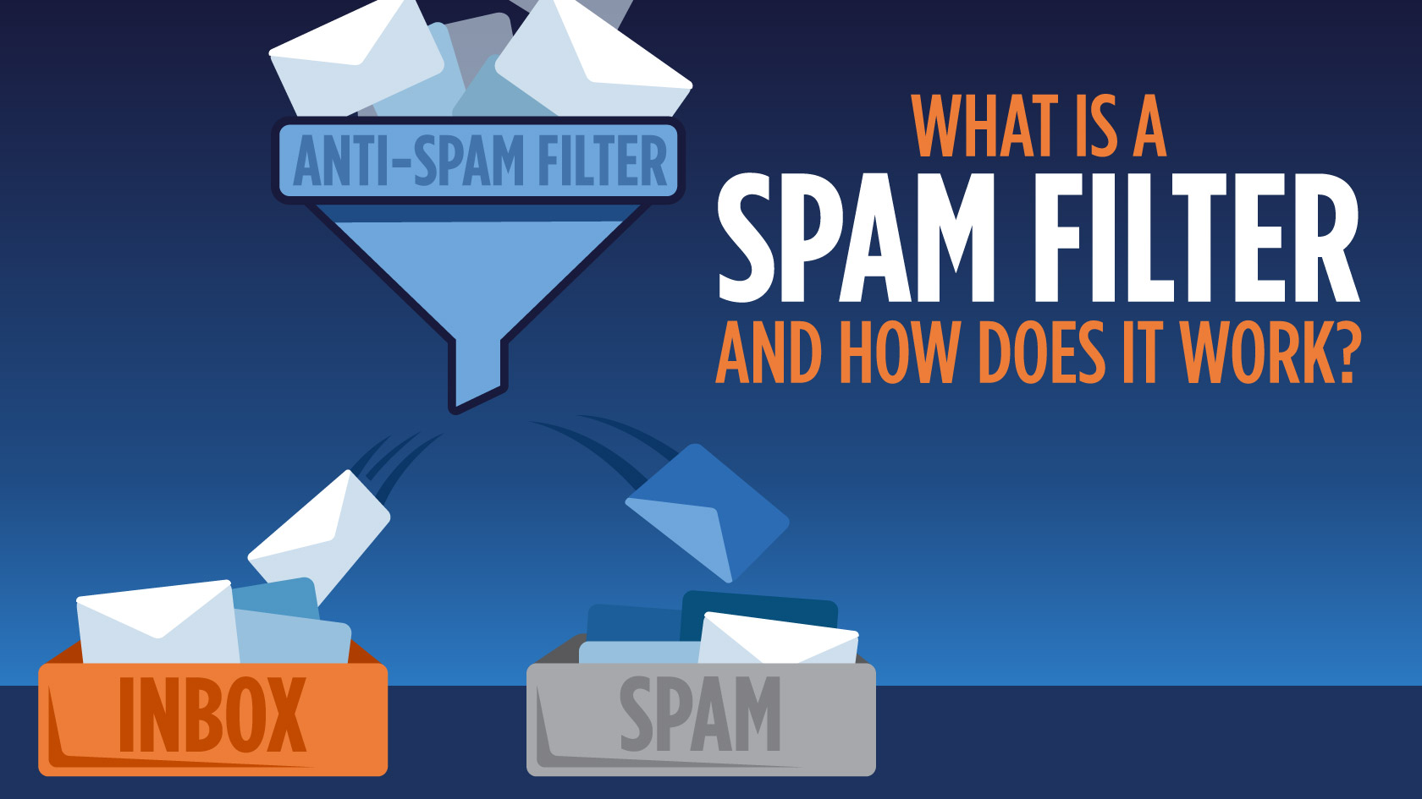
What is a classifier?
A classifier is a reasoner that looks at an input and decides what category it fits in.
The categories are called classes.

Slide 4
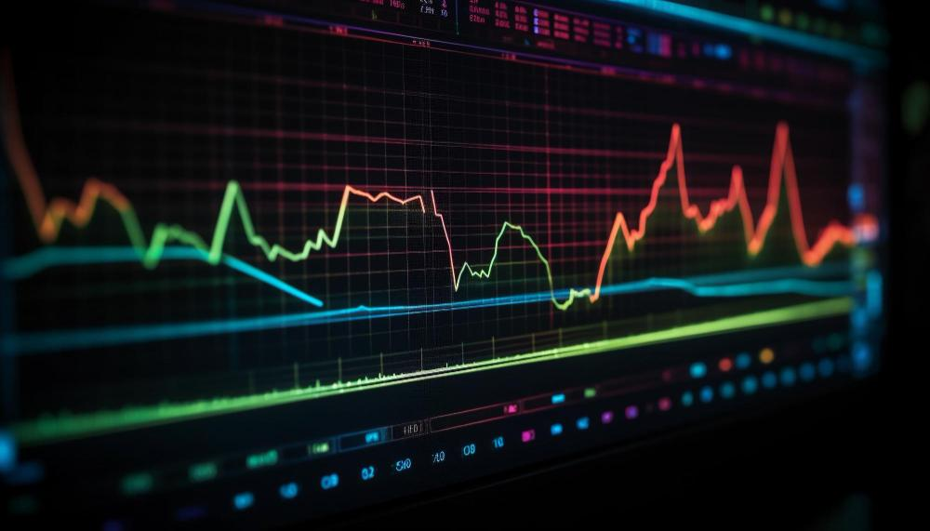
Prediction Problems
A predictor is a reasoner that estimates a numerical value.
If the predictions are about the present they’re just called estimates.
If the predictions are about the future they are called forecasts.
Designed by Freepik

Slide 5
Recommender Systems
Recommender systems suggest items from a large set based on knowledge about a person’s preferences and the preferences of others who resemble them:
Things this person liked in the past
People who liked the same things this person liked
Things these other people liked that this person hasn’t seen yet
  RECOMMEND those things to this person

Slide 6

Planning & Scheduling
planners and schedulers find efficient ways to accomplish complex tasks in time sensitive situations.
Designed by Freepik

Slide 7
Name the Reasoner
Student Activity
Guess which kind of reasoner is used for each of 15 images

Slide 8
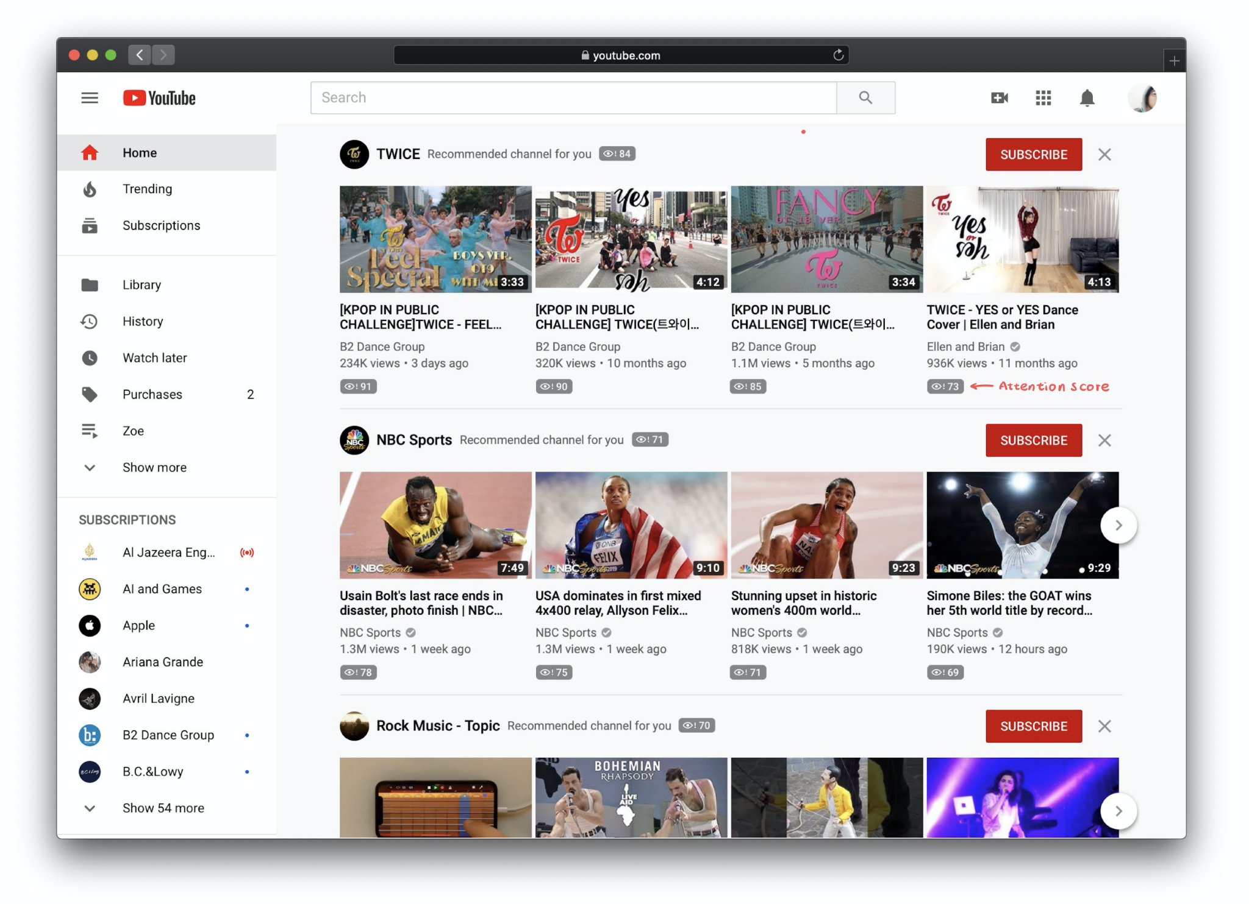
YouTube

Slide 9
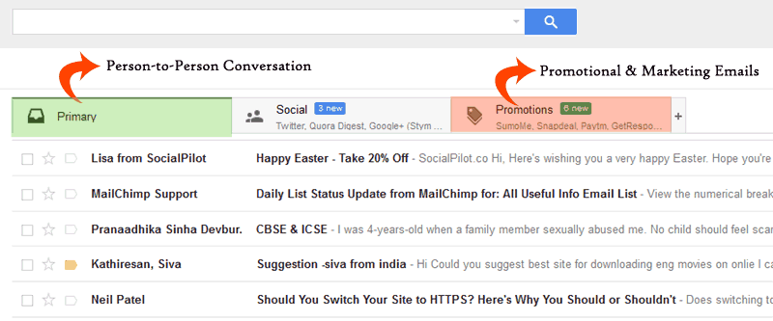
Auto Filters in Email

Slide 10
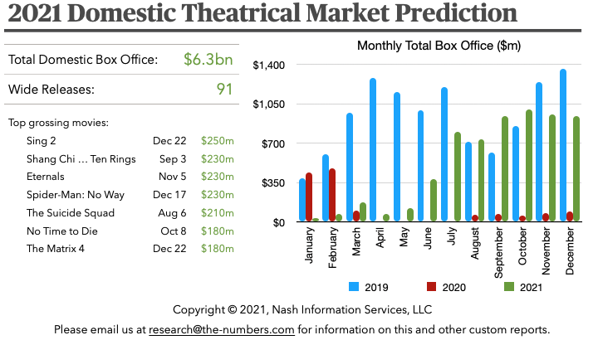
Movies (ticket sales)

Slide 11
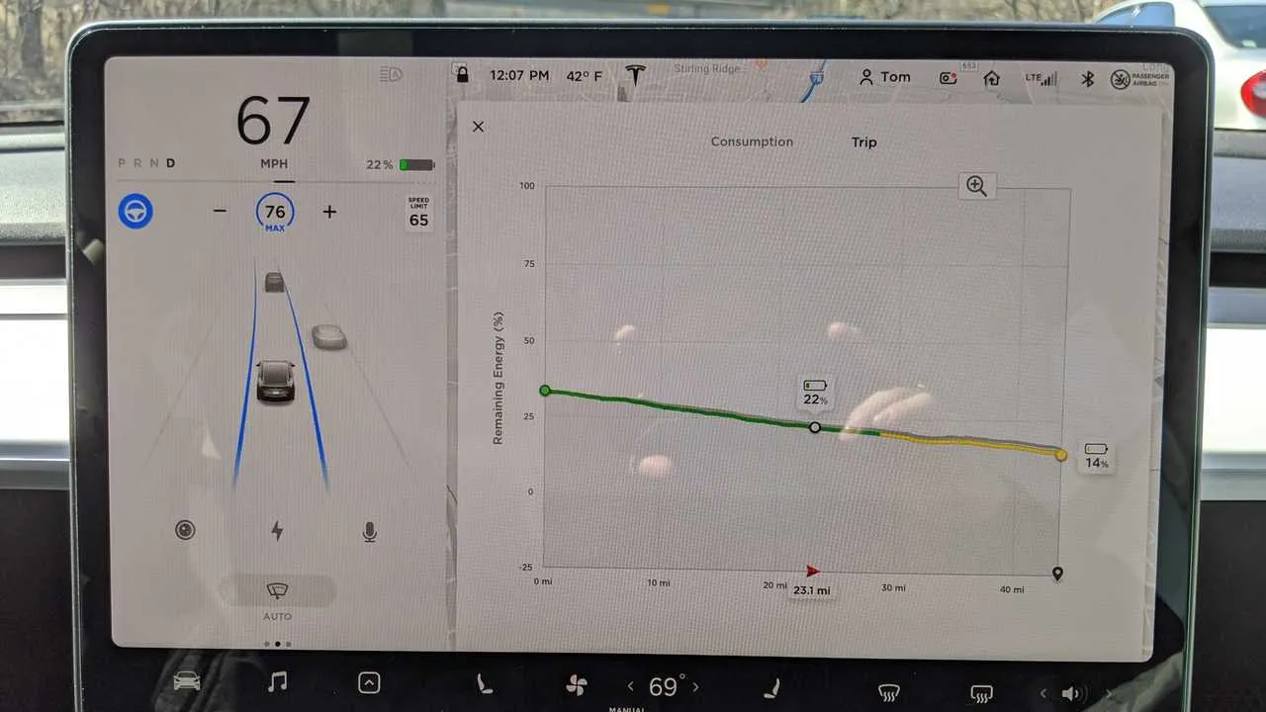
Tesla Range before recharging

Slide 12
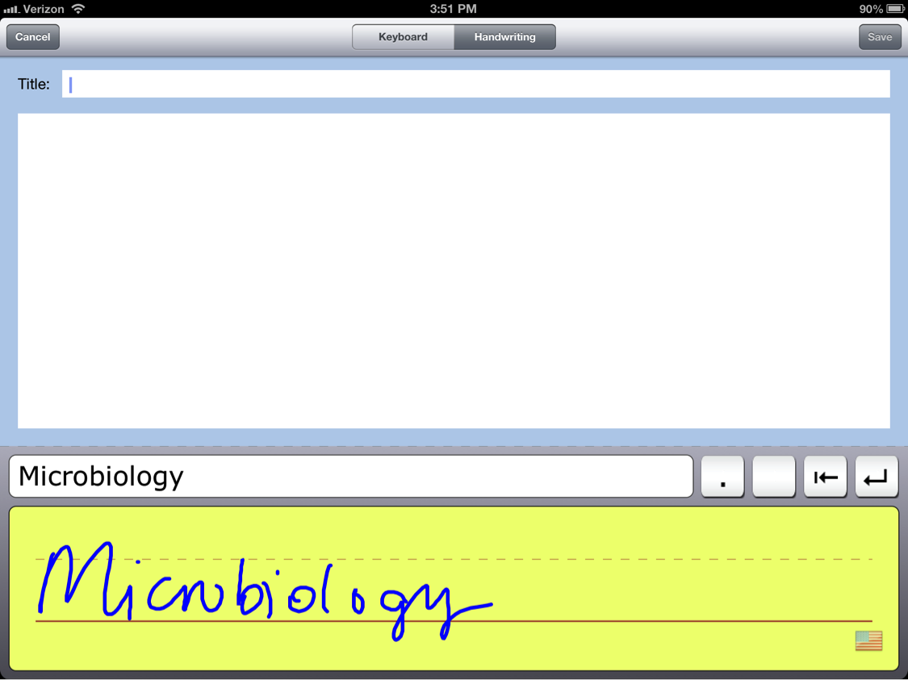
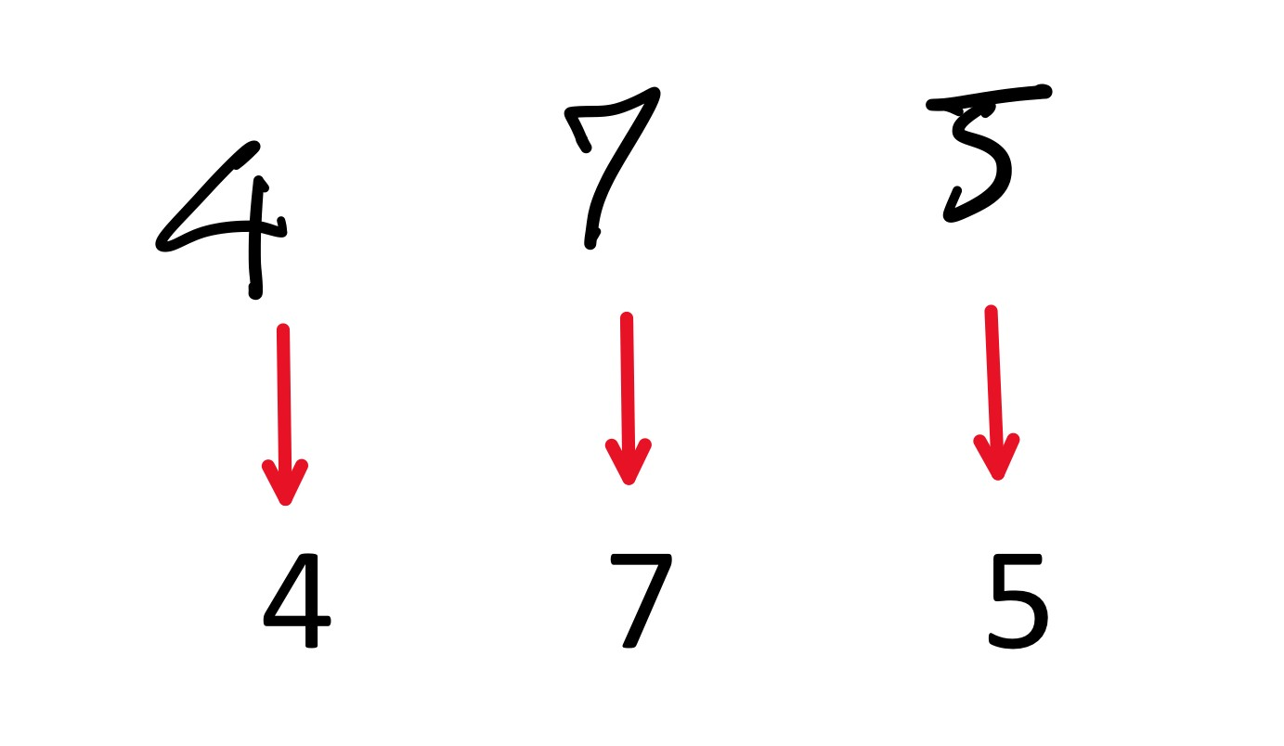
Handwriting Recognition

Slide 13
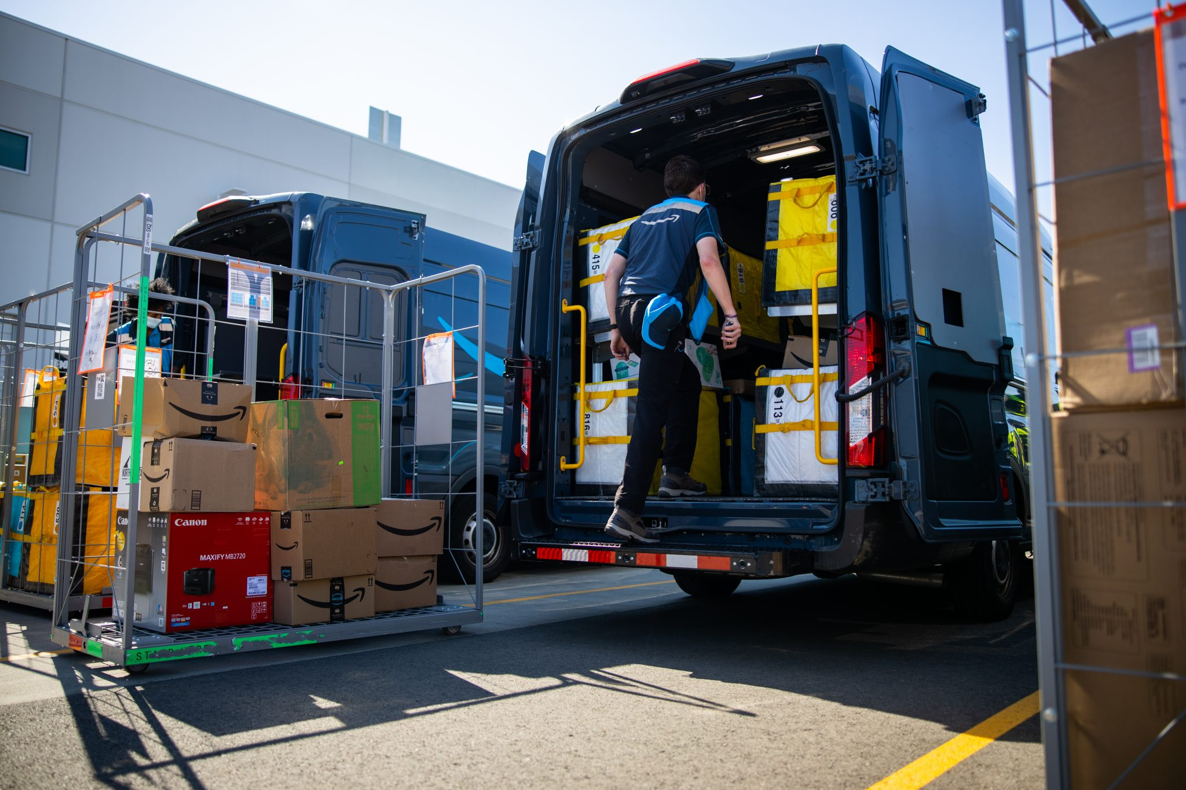
Package Delivery

Slide 14
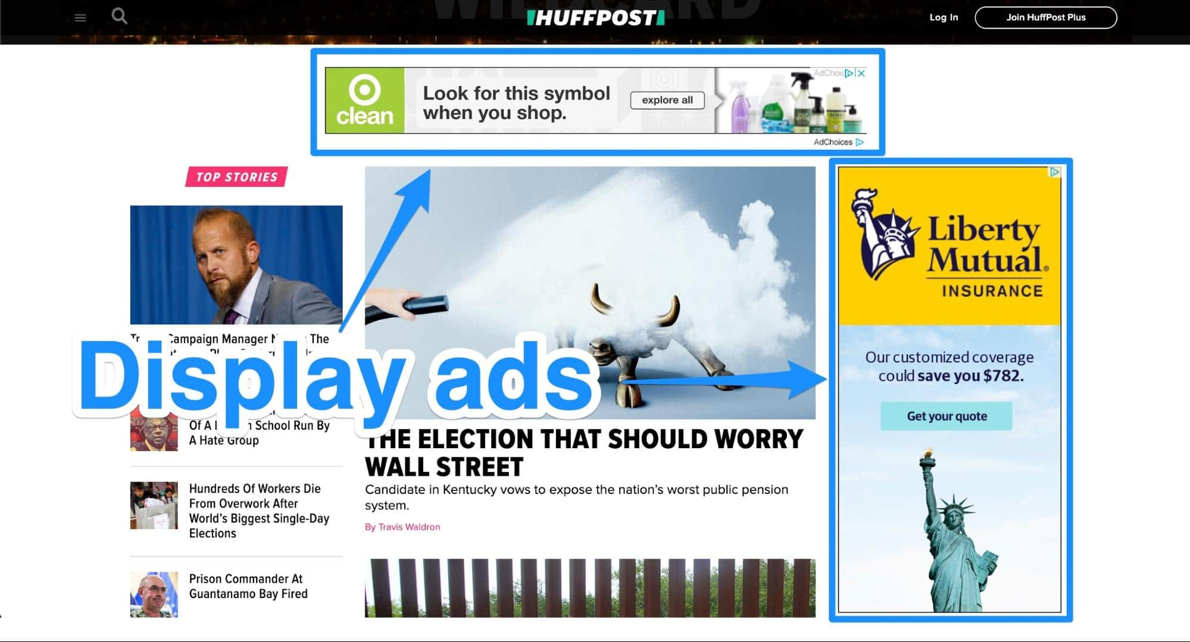
Advertisement

Slide 15
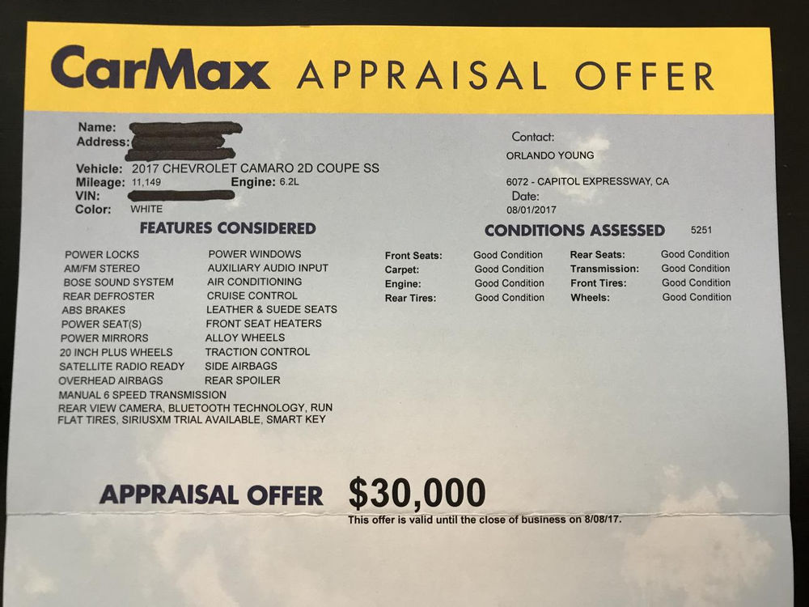
Carmax

Slide 16
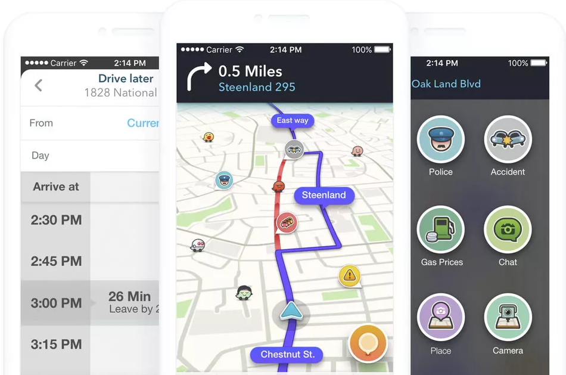
Waze

Slide 17
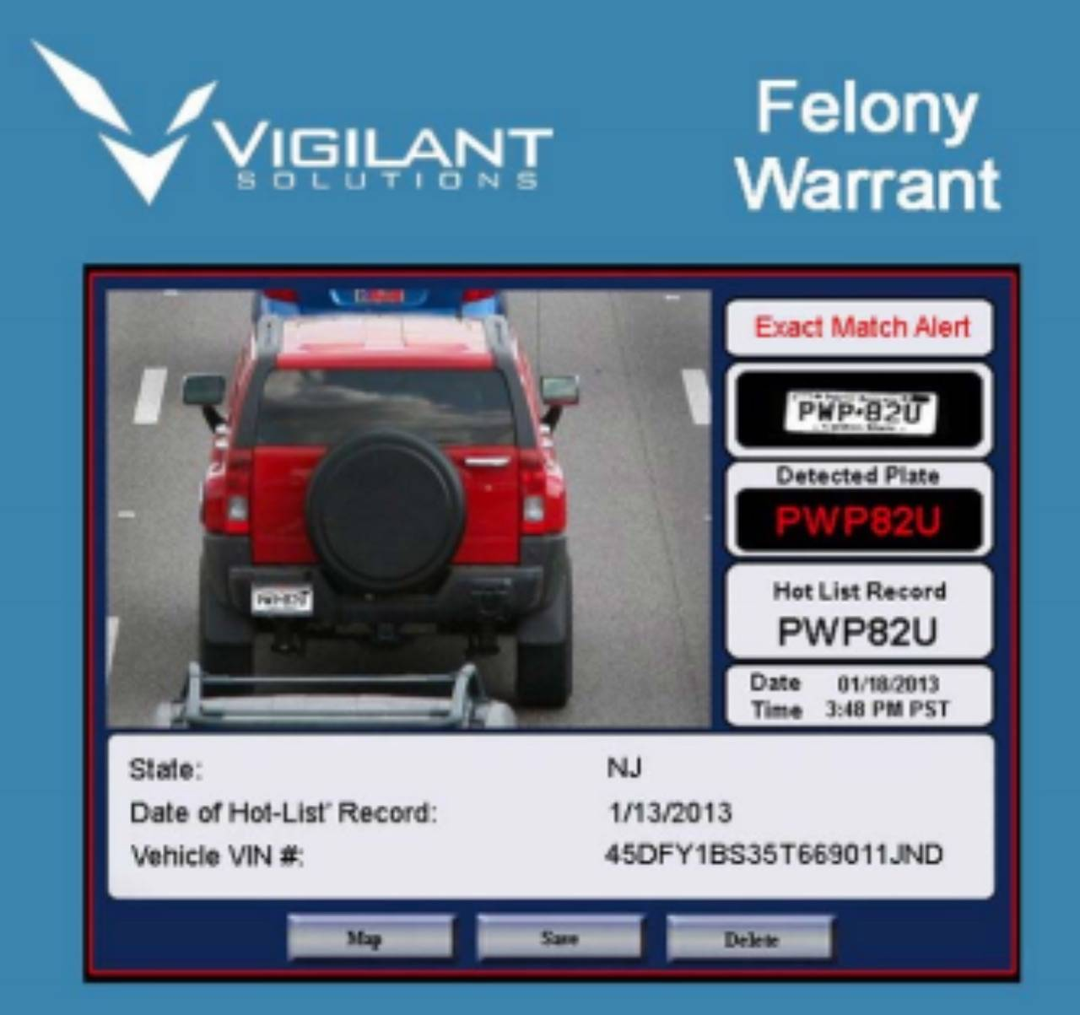
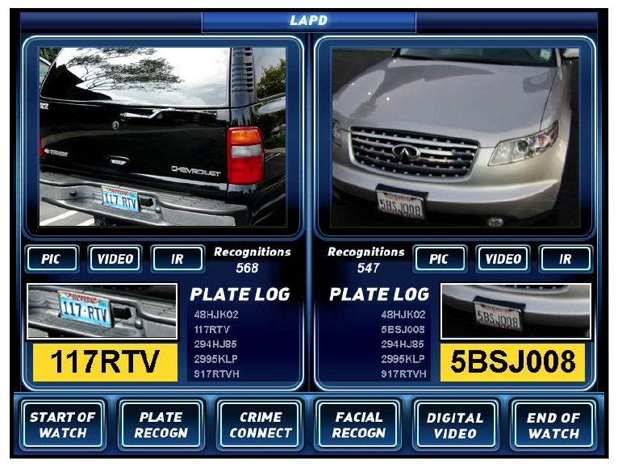
License Plate Reader

Slide 18
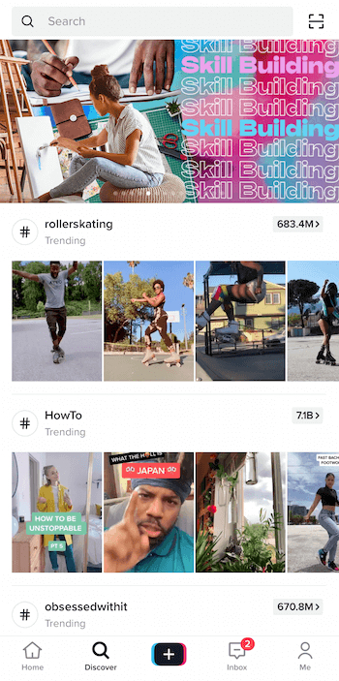
Tiktok Discover

Slide 19
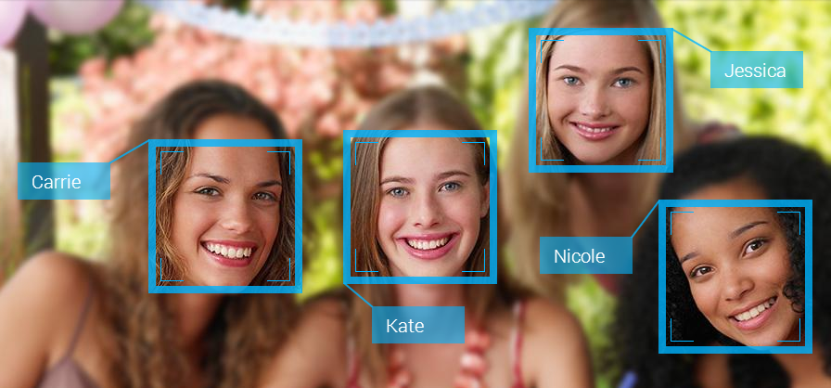
Face Tagging

Slide 20

Amazon Warehouses

Slide 21
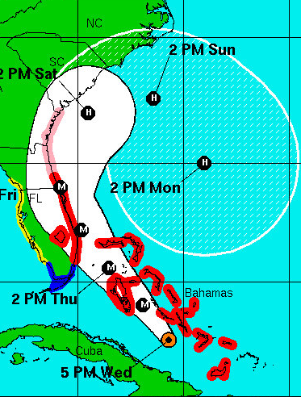
Hurricane Tracker

Slide 22

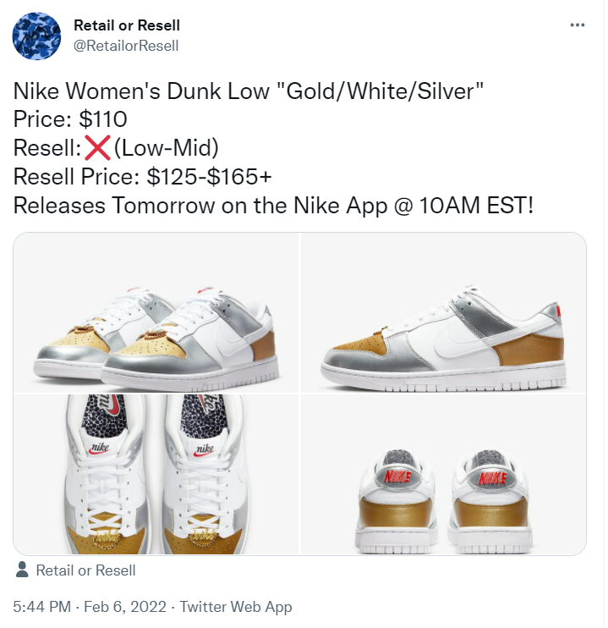
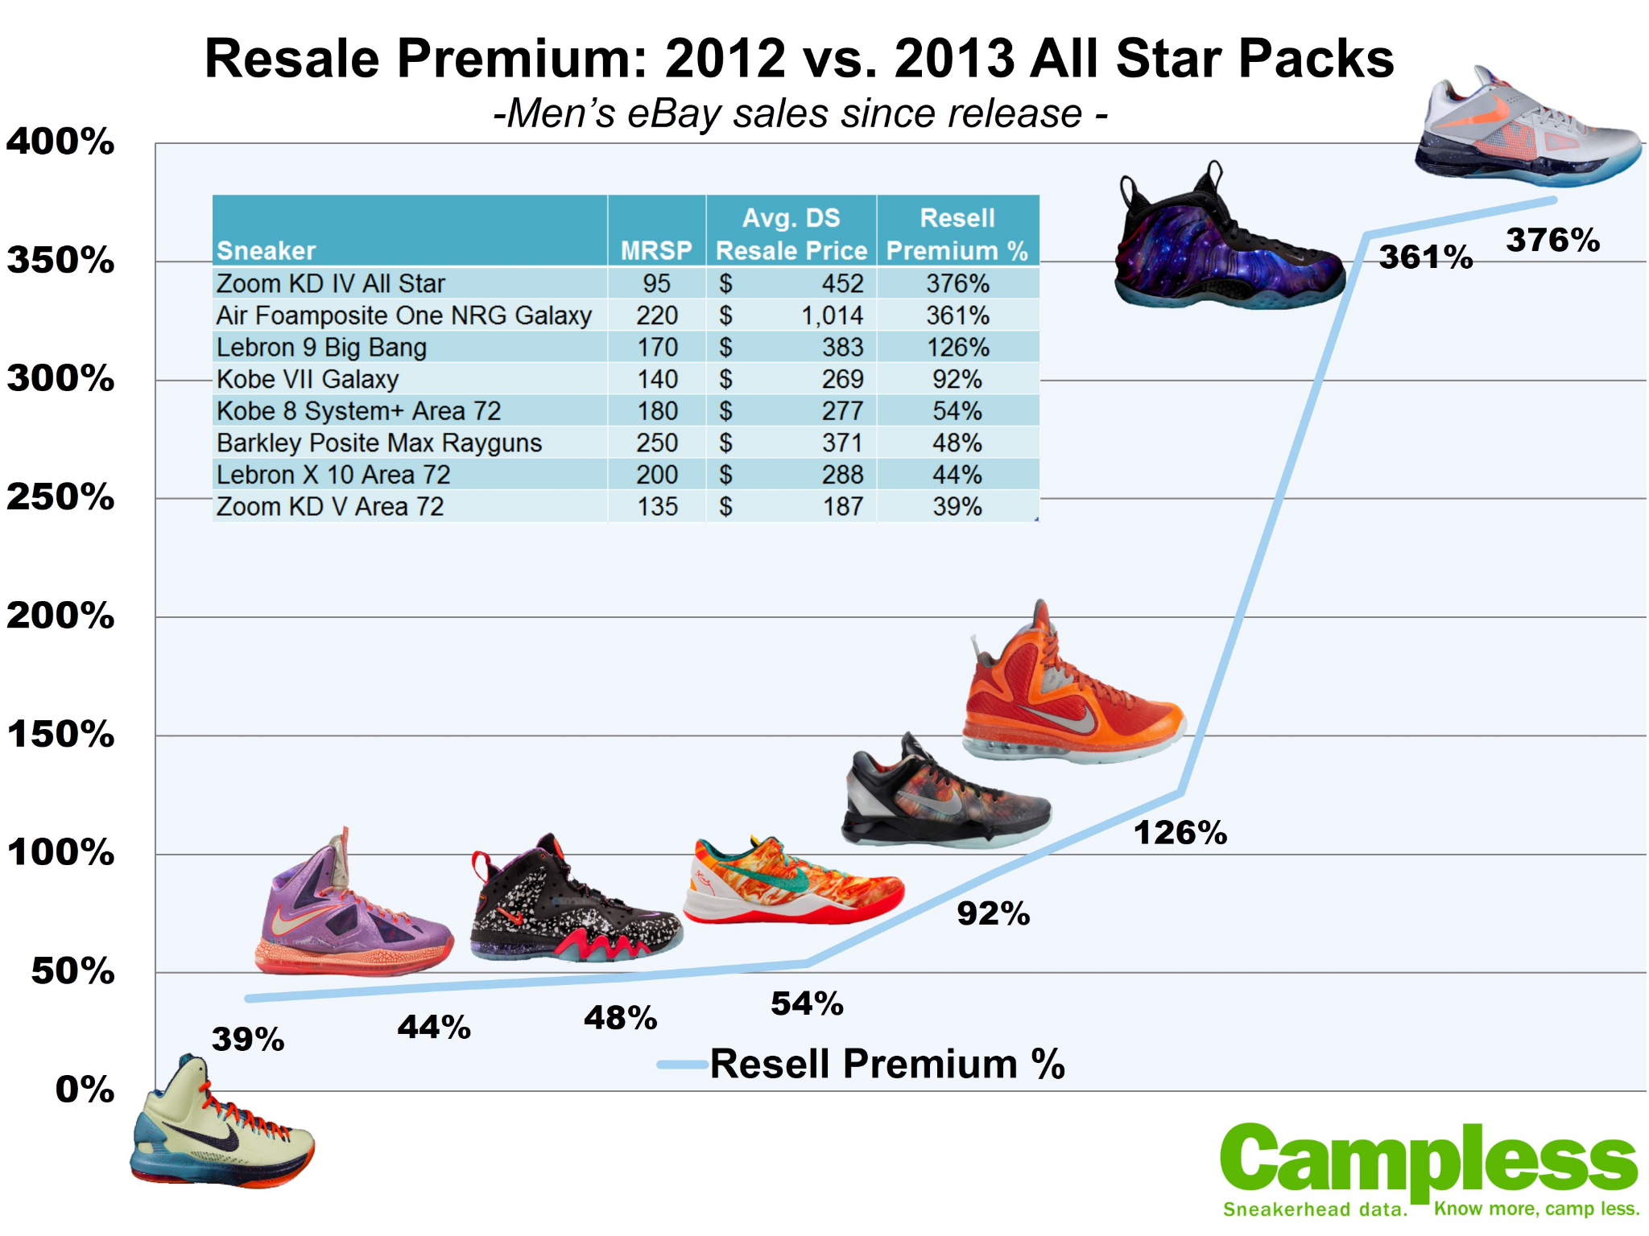
Sneaker Resale

Slide 23
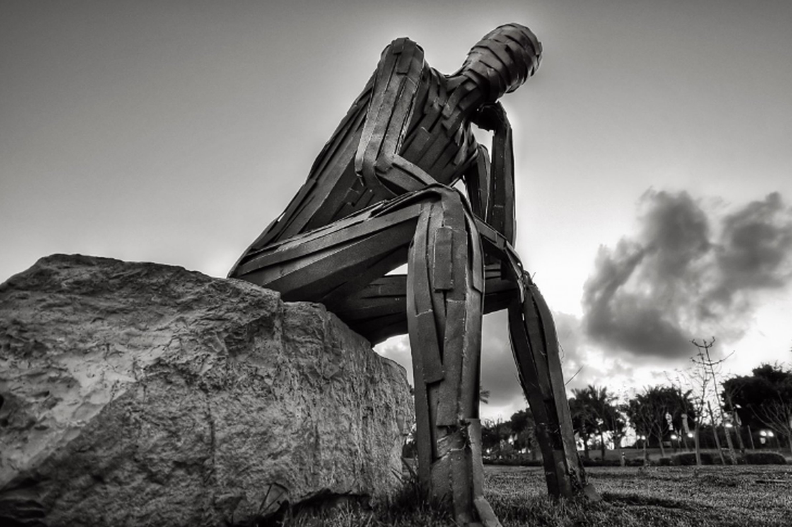

Think about how your life is being affected by the decisions computers are making for you.
Reflection & Discussion

Slide 24
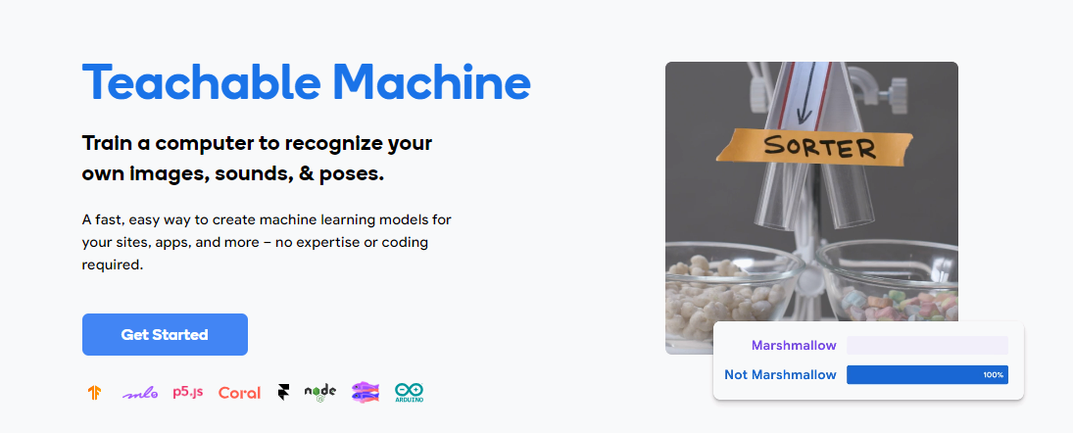
Make Your Own Image Classifier
Student Activity

Slide 25


Slide 26
Try It: Thumbs up vs Peace sign Classifier
Goal: Train a classifier to identify peace sign, thumbs up, or neither of these
Step 1: Open teachable machine - https://teachablemachine.withgoogle.com/
Step 2: Watch the Getting Started video (scroll down on the page for video).
Step 3: Create a peace sign class, and train it with peace sign gestures
Step 4: Create a thumbs up class, and train it with thumbs up gestures
Step 5: Create a none of the above class, and train it with no hand gestures or no peace or thumbs up sign
Step 6: Build model,
Step 7: Test out model yourself and improve it
Step 8: Then have a friend test your model and improve it

Slide 27
How to Improve your Classifier
Reflection
How well does your classifier do? Does it classify the input correctly?
If your model doesn’t classify your test input correctly, check to see if you have any of the following issues
All your training images look the same: not enough variation
Not enough images (less than 30)
The test images don’t look like the training images: training set is not representative of the test set
You don’t have a null (“none of the above”) class where no gesture is being made
The differences between the two classes are very subtle

Slide 28
The Teachable Machine Pipeline
In Module 3.1, we created a dataset and trained a visual classifier for peace sign vs thumbs up
Build Dataset
Test
Identify the question
Identify the classes (labels)
Collect your data for each class
Train a classifier
Collect test data
If accuracy low
Use the model in a system
If accuracy is high
Test the model with users
If accuracy is high
Review Accuracy
Test the model

